Slide 1
Problems
Eoghan Byrne

Slide 2
Types of Computer
There are many different types of computer:
general purpose - PCs, Laptops etc
specialised - servers, routers,microcontrollers

Slide 3
Functions
In general computers can do four things:
Input (accepts data)
Processing (processes data)
Output (produces output)
Storage (save results)

Slide 4
Example
Using one specific computing device (i.e. your smartphone) give examples of these four functions in action:
Type of Computer: iPod Touch
Keystrokes and/or physical buttons
Wi-Fi Connection
Speaker (Sound)
Storage space (Photos)

Slide 5
Why Computers?
What advantages/disadvantages are there when using a computer for a task, compared to a human?
(list as many reasons as you can)
Pros | Cons
Compute large arithmetic equations quickly | Speed dependent on space and memory
Can edit photographs | Can’t compute English (Not Directly)
Can take a physical input and produce a digital output | Can malfunction at times
Can control hundreds of other computers under it | Brakes easier!

Slide 6
List some Apps that are used for...
Storing of information
Photos
Drive
Dropbox
OwnCloud

Slide 7
List some Apps that are used for...
Retrieving information
Gmail
Viber

Slide 8
List some Apps that are used for...
Sending or communicating information
Facebook
Twitter
Instagram
MailChimp

Slide 9
List some Apps that are used for...
Modifying or transforming information.
FTP
Text Edit

Slide 10
Hardware/Software
What is the difference between hardware and software?
Hardware is the physical item.
Software is the stuff on the hardware i.e OS

Slide 11
What are the following for?
CPU - Central Processing Unit (Calculations)
GPU - Graphics Processing Unit (Graphics)
RAM - Random Access Memory (Memory)
Motherboard - Master PCB board (Adding Hardware)
Hard Drive - Storage

Slide 12
Software I
What is an operating system (OS) ? List some variants.
An OS in an Operating System
E.G. Windows, OS X, Linux & Chrome OS

Slide 13
Software II
In relation to computer software, what are drivers?
Drivers are pieces of software that allow you to connect to the hardware.

Slide 14
Networks
What do computer networks allow us to do?
They allow numerous computers talk to one another
What is the difference between the world wide web (www) and the internet?
The difference is the Internet is an infrastructure of networks were as the World Wide Web is a way of accessing the Internet

Slide 15
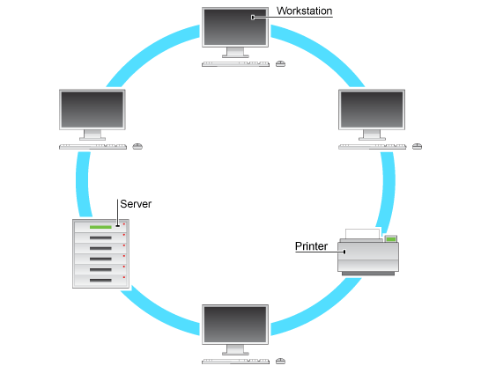
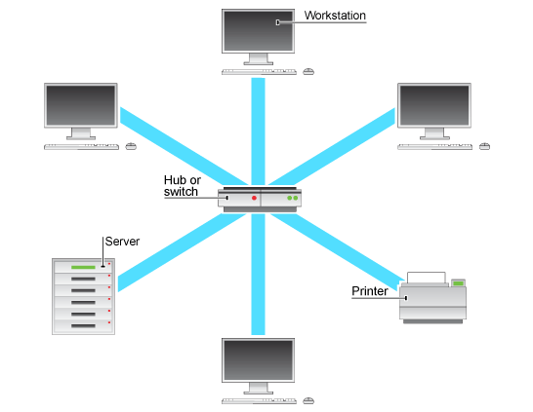
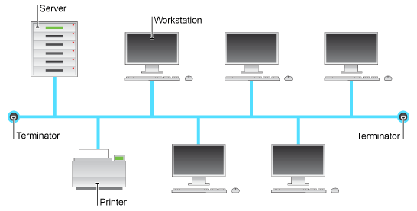
Network Topologies
What do the following network configurations look like?
Which configuration do you think this lab uses?
Bus
Ring
Star
Bus

Slide 16
Acronyms
Explain:
LAN - Local Area Network
WAN - Wide Area Network
MAN - Metropolitan Area Network

Slide 17
Protocols
A protocol is simply an agreed way of doing things. For instance, social protocol dictates that if someone greets you with “Dia duit” you reply with “Dia is Muire duit”
Computers have similar - albeit more robust - communication protocols.

Slide 18
What are these Protocols for?
SMTP/POP3 - Email
FTP - File Transport
TCP/IP - Network Access

